Slide 1
Chapter 1 Objectives
The CCNA Topics Covered in this chapter include:
  What is NAT?
  NAT Terminology
  Types of NAT

Slide 2
What is NAT?
Similar to Classless Inter-Domain Routing (CIDR), the original intention for NAT was to slow the depletion of available IP address space by allowing many private IP addresses to be represented by some smaller number of public IP addresses.

Slide 3


NAT – Network Address Translation
NAT
Translates between local addresses and public ones
Many private hosts share few global addresses
Private Network
Public Network
Uses private address range
(local addresses)
Uses public addresses
Local addresses may not
be used externally
Public addresses are
globally unique

Slide 4
Benefits of NAT
You need to connect to the Internet and your hosts don’t have globally unique IP addresses.
You change to a new ISP that requires you to renumber your network.
You need to merge two intranets with duplicate addresses.

Slide 5
NAT Addressing Terms
Inside Local
  The term “inside” refers to an address used for a host inside an enterprise. It is the actual IP address assigned to a host in the private enterprise network.
Inside Global
  NAT uses an inside global address to represent the inside host as the packet is sent through the outside network, typically the Internet.
  A NAT router changes the source IP address of a packet sent by an inside host from an inside local address to an inside global address as the packet goes from the inside to the outside network.

Slide 6
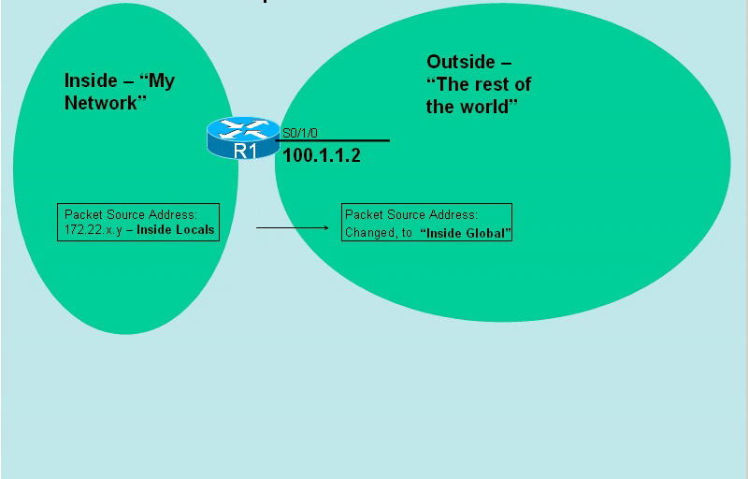
Inside/Outside

Slide 7
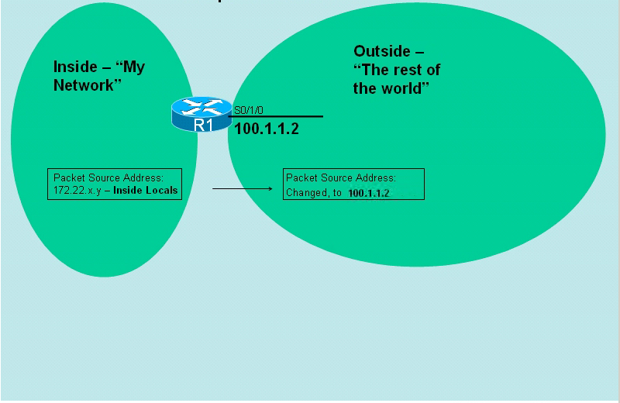
Inside/Outside

Slide 8
NAT Addressing Terms
Outside Global
  The term “outside” refers to an address used for a host outside an enterprise, the Internet.
  An outside global is the actual IP address assigned to a host that resides in the outside network, typically the Internet.
Outside Local
  NAT uses an outside local address to represent the outside host as the packet is sent through the private network.
  This address is outside private, outside host with a private address

Slide 9
Three types of NAT
Static
Dynamic
Overloading

